Slide 2
Cordova: Less of a (phone)gap than ever
Damian Karzon
M334

Slide 3
What and Why of Cordova Tools and Frameworks Platform integration

Slide 4
Apache Cordova is a platform
for building native mobile
applications using HTML, CSS
and JavaScript

Slide 5
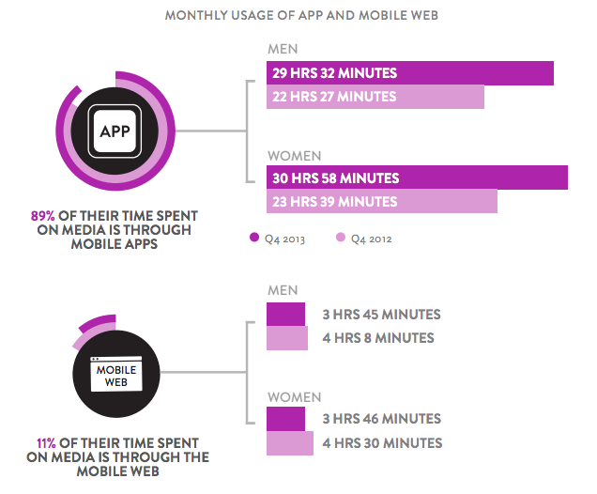
More time in apps than mobile web
http://www.smartinsights.com/marketplace-analysis/customer-analysis/consumer-media-device-use/

Slide 6

But javascript?
Javascript is everywhere*
FREE tools
Huge dev community
Notes:
http://giphy.com/gifs/javascript-framework-greensock-VHypjqI6afqpy

Slide 7
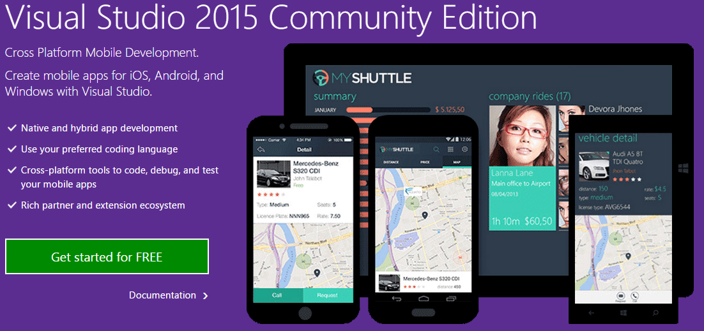

Slide 8
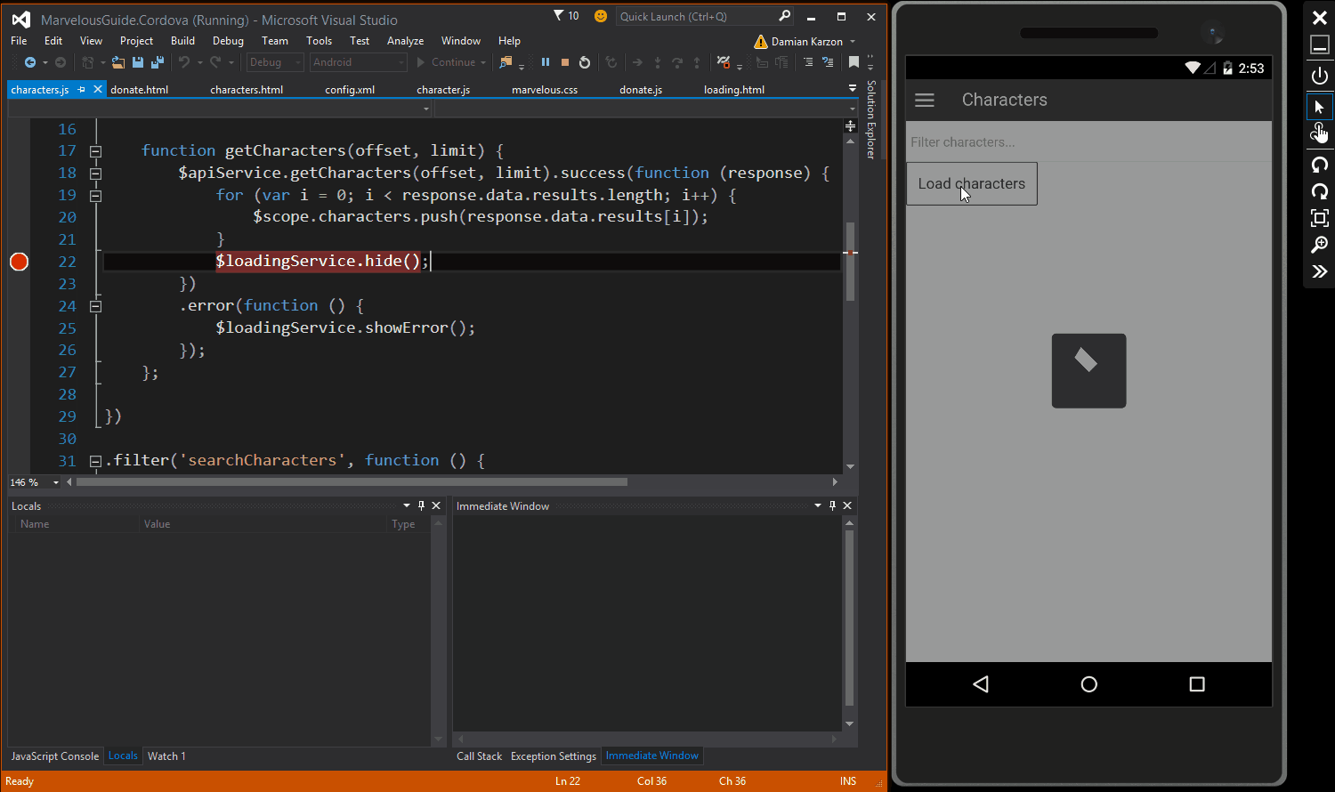

Slide 9
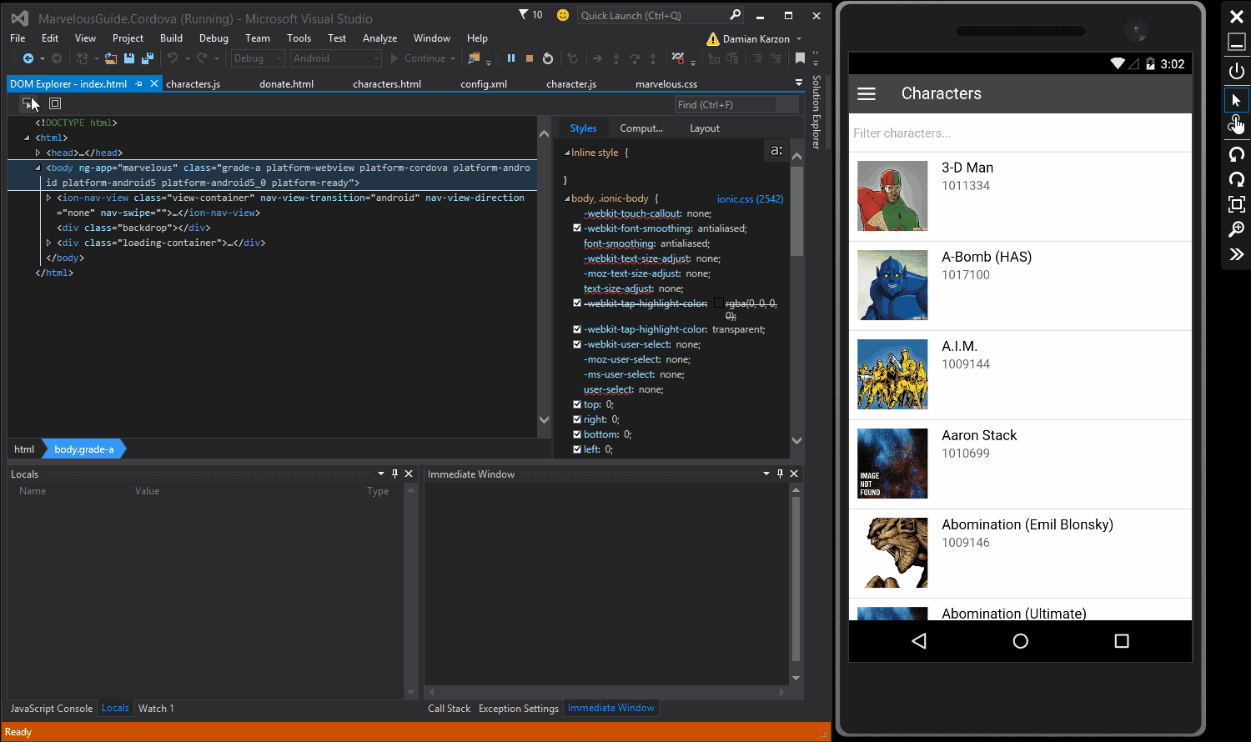

Slide 10

Vorlon.js
http://vorlonjs.com/
Remotely debug and
test your JavaScript

Slide 11
Crosswalk project
https://crosswalk-project.org/
A better web runtime for your app

Slide 12
Advantages
A Unified Rendering Engine
The Latest APIs
Higher Performance
Disadvantages
Only Available for Android 4.0 or Later
Heavier App Size
Latest Version Equivalencies with Crosswalk

Slide 13
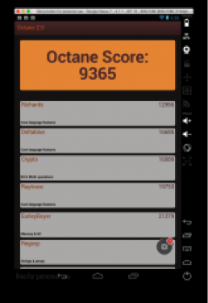

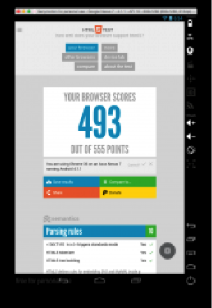
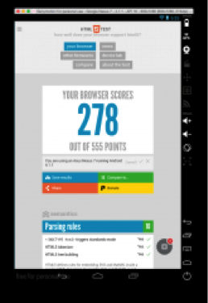
Crosswalk
Performance and API Implementation comparison
Notes:
Android 4.1
http://monaca.mobi/en/blog/crosswalk-performance/

Slide 14

Ionic Framework http://ionicframework.com/

Slide 15
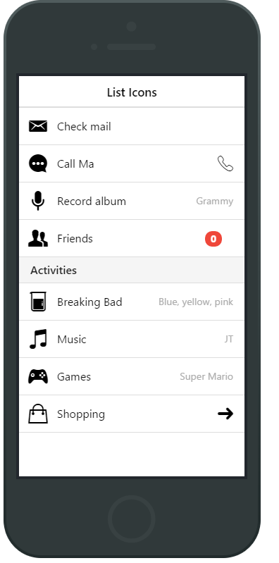
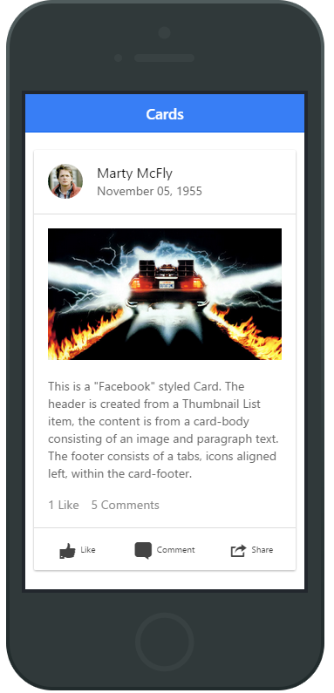
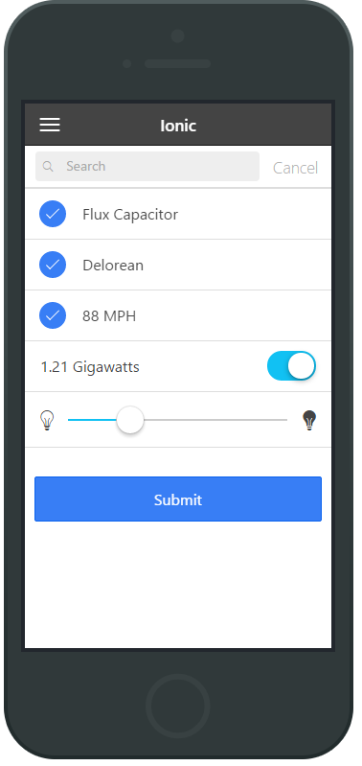
Notes:
http://pastebin.com/duVX5783

Slide 16
Sweet platform bro
Plugins and platform specifics

Slide 17
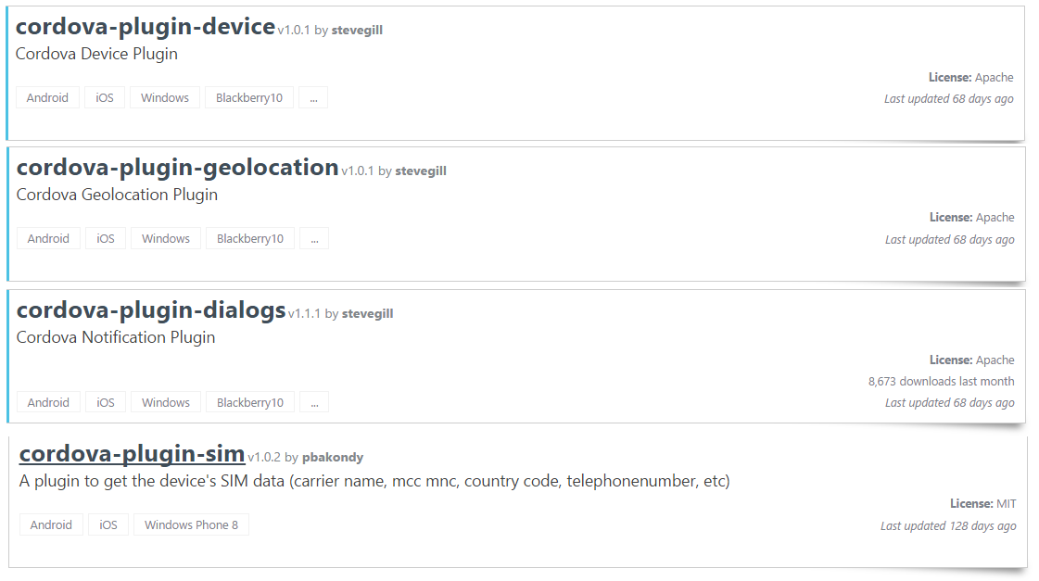
http://plugins.cordova.io/

Slide 18
Show me some code

Slide 19


Damian Karzon
App/Game/Web Developer
Marker Metro
Questions
/dkarzon
/dkarzon

Slide 20

Related Ignite NZ Sessions
1
Universal Apps: A Developers Guide
Ballroom 1 Wed 9:00am
4
Web+Mobile+IOT: Joining The Dots
NZ4 Thu 4:30pm
2
5
Devices Devices Devices!
SKYCITY Theatre Fri 1:55pm
Internet Explorer and Edge in the Enterprise
NZ1 Thu 9:00am
Find me later at…
Hub Happy Hour Wed 5:30-6:30pm
Hub Happy Hour Thu 5:30-6:30pm
Closing drinks Fri 3:00-4:30pm
Twitter: @dkarzon
3
Developing Cross Platform Mobile Apps with XAML and MVVM
NZ4 Thu 1:55pm

Slide 21





Resources
Microsoft Virtual Academy
TechNet & MSDN Flash
Free Online Learning
http://aka.ms/mva
Subscribe to our fortnightly newsletter
http://aka.ms/technetnz http://aka.ms/msdnnz
Sessions on Demand
http://aka.ms/ch9nz

Slide 22


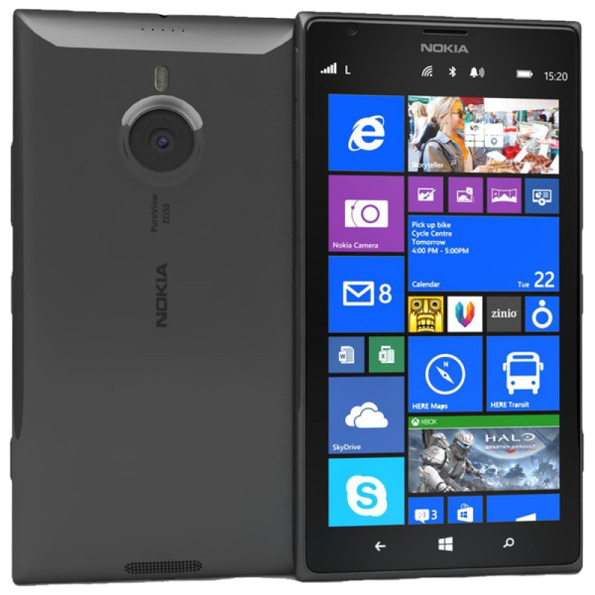


Complete your session evaluation now and be in to win!

Slide 23


